Slide 1
Angular Component Communication
Communicating through a Service
Lecture 5
By James(Jin) Wang
12/27/2021

Slide 2
Outline
Managing State
Property Bag Service
Service Scope and Lifetime

Slide 3
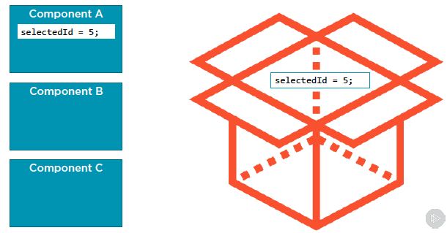
Managing State
  Communicating through a Service

Slide 4
Managing State
  What is State?

Slide 5
Summary

Slide 6
Assignment

Slide 7
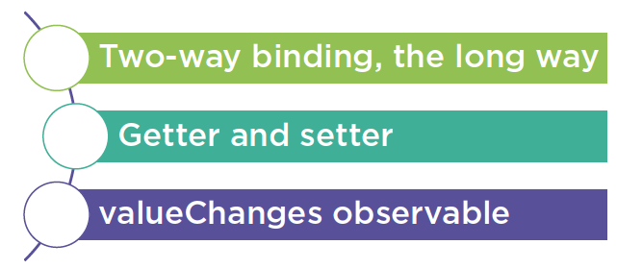
Output Properties
  Notifying the Component of User Changes
  Demo: output Property

Slide 8
Self Study
  Angular Component Communication
  https://app.pluralsight.com/library/courses/angular-component-communication

